Slide 1
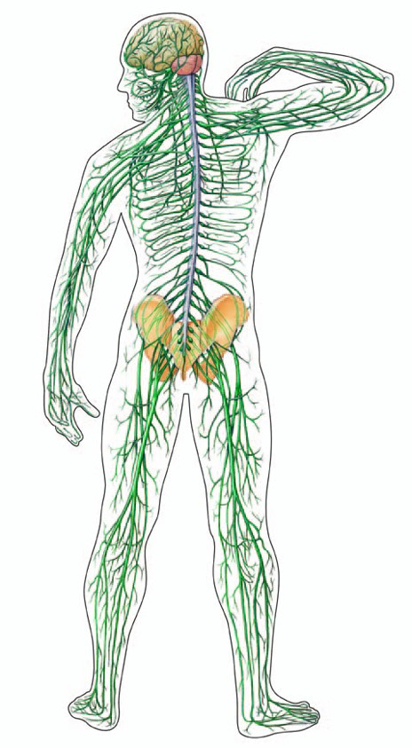
Neurological Disorders Lesson 2.1
How are neuronal structures specialized for function?
receptor
nucleus

Slide 2
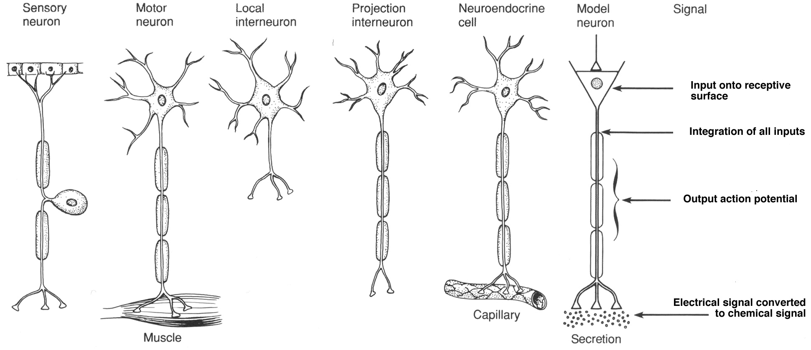
Are all neurons created the same?
Compare and contrast the neurons drawn below.

Slide 3
Neurons have many functions
What has to happen to be able to read The Cat in the Hat?

Slide 4
Neurons are Cells
Nucleus – stores DNA
Mitochondria – supplies energy
Ribosomes – synthesizes proteins
Endoplasmic reticulum – modifies proteins
Golgi apparatus – packages and directs proteins to proper locations in cell

Slide 5
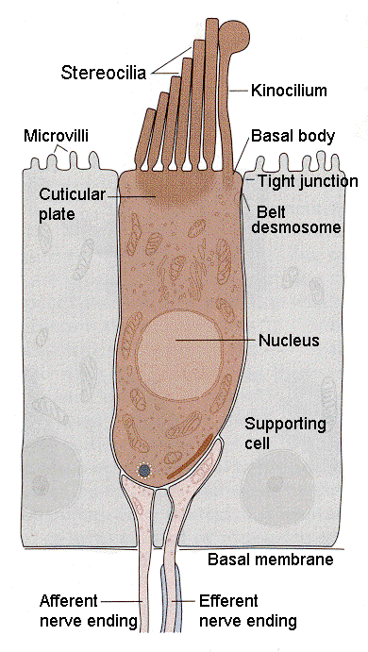
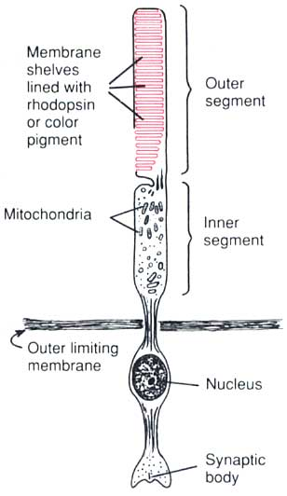
Neurons Receive Inputs
From the environment via specialized receptors
1. Sensory neuron in skin
2. Sensory neuron in ear
3. Sensory neuron in eye
receptors
receptor
receptors
nucleus
nucleus
nucleus

Slide 6
Neurons Receive Inputs
From other neurons via dendrites
Dendrites
Dendrites
Dendrites
Cell body
Cell body
Cell body

Slide 7
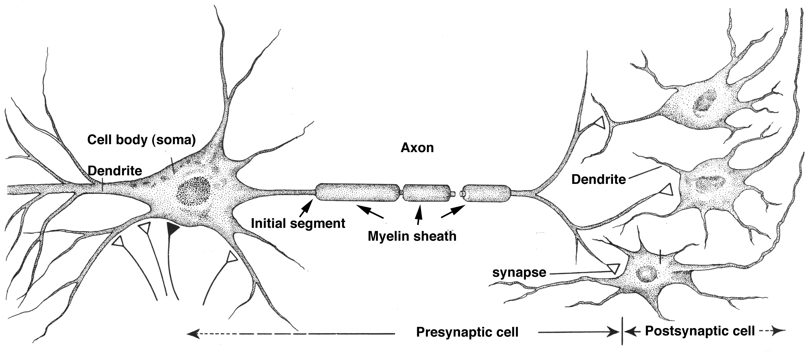
Neurons Process Inputs
Through the initial segment (determines whether or not to send a signal)
Dendrites
Cell Body
Initial Segment

Slide 8
Neurons Send Signals
Through the axon (electrically) and then the synapse (chemically).
Dendrites
Axon
Cell Body
Initial Segment
Synapse

Slide 9
Axons
Vary in Length
Longest Axon is longer than 3 feet and reaches from the spinal cord to the big toe. The shortest are just millimeters.

Slide 10
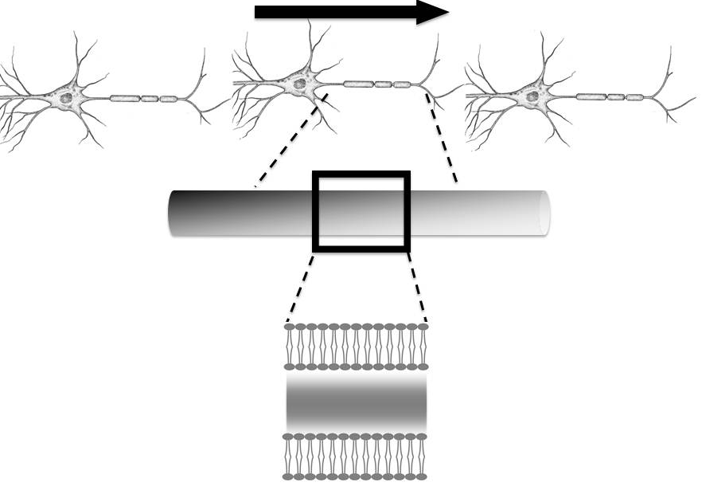
The Axon
Sends signals electrically
Axon
+ + + +
Axon’s Lipid Bilayer
- - - -

Slide 11
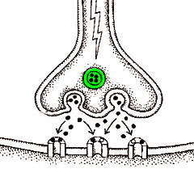
The Synapse
Sends signals chemically
Presynaptic
cell
Neurotransmitters
Postsynaptic
cell

Slide 12
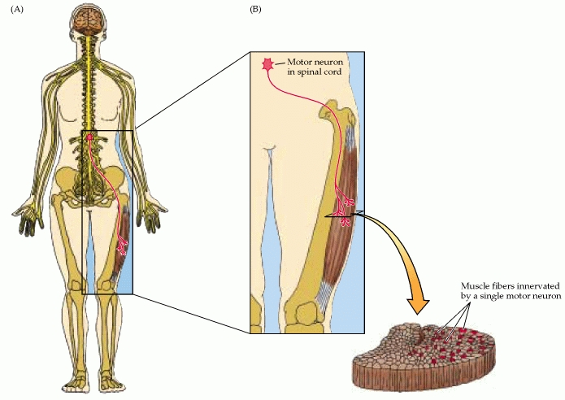
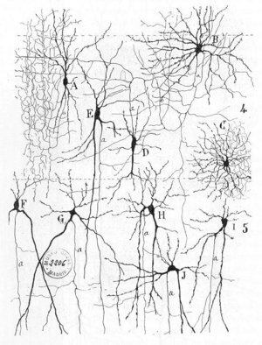
Neurons Send Signals
To other neurons
To muscles/glands

Slide 13
Parts of the Neuron
Dendrites
Axon
Cell Body
Initial Segment
Synapse
Presynaptic cell
Postsynaptic cell

Slide 14
General Neuronal Pathway
1. Sensory Neuron is activated through one of the senses.
2. The message gets relayed to an interneuron found somewhere in the brain or spinal cord. Interneurons will Interpret the message from the sensory neuron.
3. Then the message gets passed to a motor neuron to carry out the action decided by the interneuron. Ex. Move a muscle, secrete a substance.

Slide 15
Create a Neuronal Pathway
Group 1: It’s Monday morning and Joe hears the beeping of his alarm clock and reaches out to hit the snooze button. Model the neurons and their connections required to hear the alarm clock and hit the snooze button.
Group 2: Joe realizes he is hungry when he smells his dad making breakfast (bacon and eggs). His mouth starts to salivate and his stomach starts to grumble. Model the neurons and their connections required to smell breakfast and have the reaction of mouth salivating and stomach grumbling.
Group 3: As Joe opens the door to leave for school, he realizes it’s colder than he thought. He walks back inside to get his warmer coat. Model the neurons and their connections to feel that it’s cold and walk back to get a coat.
Group 4: While on the T, Joe reviews for a Spanish quiz. He looks at flashcards with vocabulary to test his memory. Model the neurons and their connections to see the flashcards and test language memory.
Group 5: At basketball practice, Joe warms up by practicing his free throw. Model the neurons and their connections required to shoot a basketball – remember that you use both your arms and your legs.
Group 6: Joe finishes basketball practice. He reaches for a Gatorade and takes a sip. Model the neurons and their connections to reach for a Gatorade and taste its flavor.

Slide 16
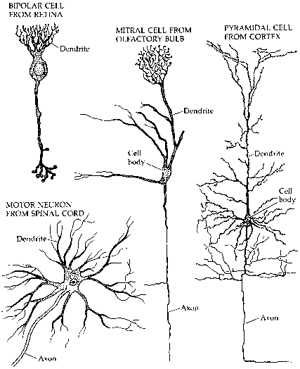
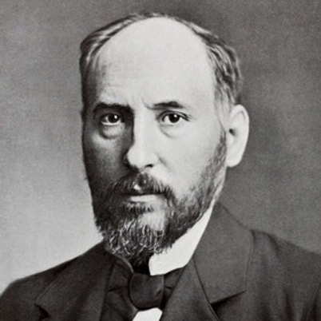
Are all neurons created the same? Why not?
Bipolar cell from retina
Neuron from olfactory bulb
Neuron from cortex
Santiago Ramon y Cajal
Motor neuron from spinal cord

